Slide 2

Integrating AI and emerging technologies in VET teaching and learning
Boglárka FEKETE dr.
National Team of VET Experts from Hungary

Slide 3
The EU is moving through a profound digital transition
Labour markets are transforming rapidly
VET carries a unique responsibility
AI
VET

Slide 4
1. EU strategic and regulatory landscape
2. How AI transform VET
3. Building VET Teacher Digital Competence
4. Ethical use of AI
5. Aligning VET with Europe’s Digital Transition & Future Skills Agenda

Slide 5

1. EU Strategic & Regulatory Landscape
Support for SMEs adopting new technologies
Large-scale skills partnerships under the Pact for Skills
The need for advanced digital skills in emerging sectors
https://employment-social-affairs.ec.europa.eu/policies-and-activities/skills-and-qualifications/european-skills-agenda_en

Slide 6
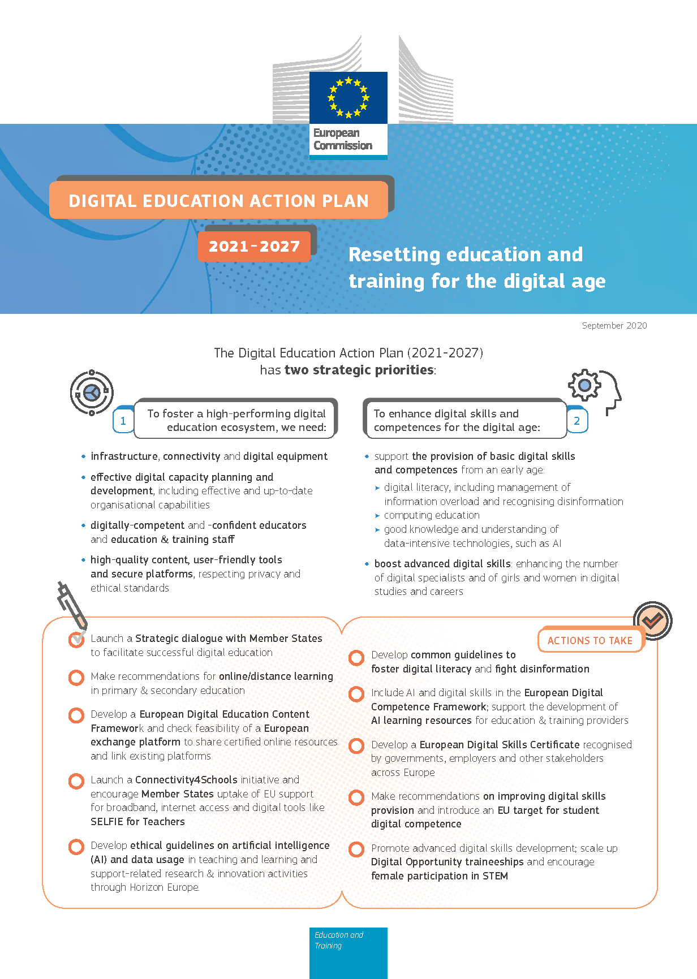
1. EU Strategic & Regulatory Landscape
Developing a highly effective digital education ecosystem
Enhancing digital competences for the digital transformation
AI literacy
infrastructure
connectivity
teacher training
institutional digital strategies
digital learning platforms
data literacy
awareness of AI ethics
computational thinking
https://education.ec.europa.eu/focus-topics/digital-education/actions

Slide 7

1. EU Strategic & Regulatory Landscape
AI must include human oversight
Datasets must be high-quality and bias-free
AI must be transparent
Institutions must conduct risk assessments
https://artificialintelligenceact.eu

Slide 8


1. EU Strategic & Regulatory Landscape
https://publications.jrc.ec.europa.eu/repository/handle/JRC128415
https://publications.jrc.ec.europa.eu/repository/handle/JRC107466

Slide 9
1. EU Strategic & Regulatory Landscape
Stronger cooperation with companies
VET innovation ecosystems
Agile VET curricula
https://www.cedefop.europa.eu/files/osnabrueck_declaration_eu2020.pdf

Slide 10
1. EU Strategic & Regulatory Landscape
Innovation hubs
Research networks
Cooperation platforms
Cross-border experimentation projects
https://education.ec.europa.eu

Slide 11

2. How AI & emerging technologies transform VET
AI-powered personalised learning
Simulations, VR/AR, and immersive learning
train learners safely in hazardous environments
personalised learning pathways
automatic adjustment of difficulty levels
learning analytics that identify gaps in real time
targeted interventions for at-risk learners.
reduce material costs
increase opportunities for practice
provide experiences that would otherwise be impossible or too expensive

Slide 12

2. How AI & emerging technologies transform VET
AI-supported assessment & tutoring
Robotics, IoT, smart equipment in VET labs
realistic work simulations,
computer vision can analyse welding quality or hairdressing movements,
NLP-based tools can evaluate communication skills,
AI tutors can provide immediate feedback on practical tasks
up-to-date training aligned with employer needs,
digital-readiness for Industry 4.0 and 5.0 roles

Slide 13

2. How AI & emerging technologies transform VET
Generative AI
generate customised case studies or role-play scenarios,
translate technical content into multiple languages,
draft initial versions of learning materials,
support inclusion by providing simplified or adapted content

Slide 14

3. Building VET Teacher Digital Competence
Teachers must be able to:
understand how AI tools work,
select appropriate methods,
integrate them into pedagogy,
ensure data protection and ethical use,
and support learners’ digital competences
https://education.ec.europa.eu/selfie-for-teachers

Slide 15
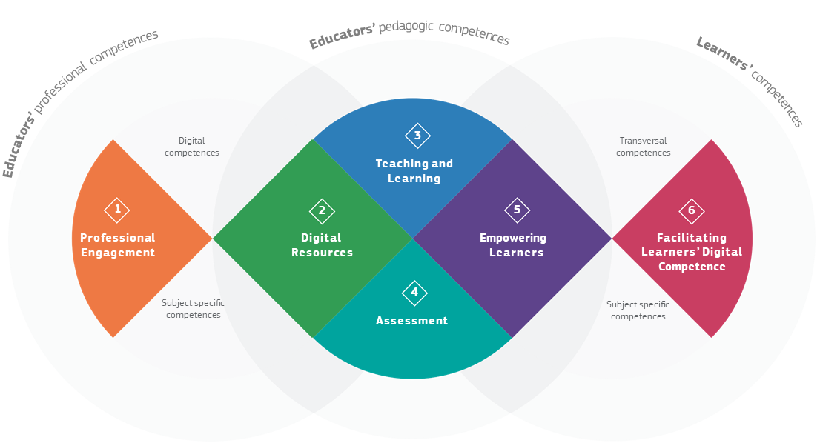
3. Building VET Teacher Digital Competence
DigCompEdu
designing digital resources adapted to workplace needs,
using simulations and digital assessments,
guiding students in using digital tools safely,
fostering collaboration with companies through digital means

Slide 16
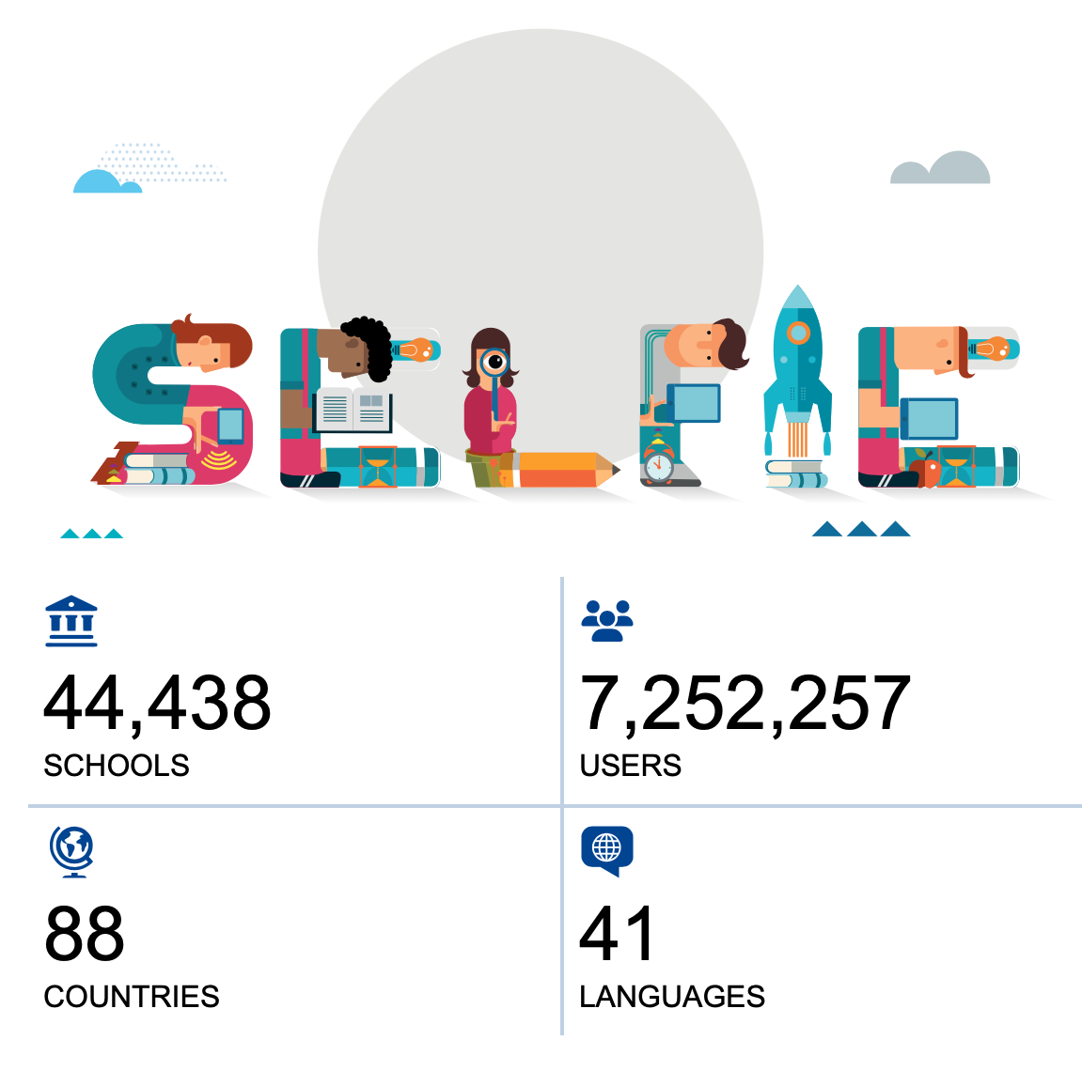
3. Building VET Teacher Digital Competence
Institutions need:
infrastructure,
digital transformation strategies aligned with DEAP,
leadership commitment,
data protection policies and GDPR compliance,
strategic partnerships with industry
https://education.ec.europa.eu/selfie

Slide 17

4. Ethical, transparent & quality-assured use of AI
European guidelines emphasise:
human-centredness,
transparency,
accountability,
non-discrimination,
inclusion,
privacy and security
VET institutions must:
ensure data quality and representativeness,
maintain documentation and logs,
provide human oversight,
ensure robustness and accuracy,
identify and mitigate risks

Slide 18
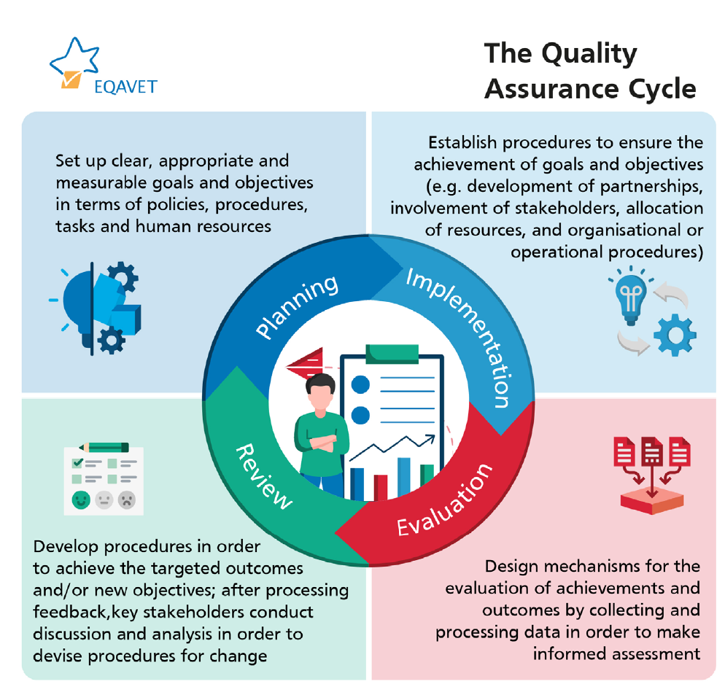
4. Ethical, transparent & quality-assured use of AI
Learners must understand:
how AI tools work,
their benefits and limitations,
risks related to privacy, bias, or misinformation,
how to evaluate outputs critically
https://employment-social-affairs.ec.europa.eu/policies-and-activities/skills-and-qualifications/working-together/eqavet-european-quality-assurance-vocational-education-and-training_en

Slide 19
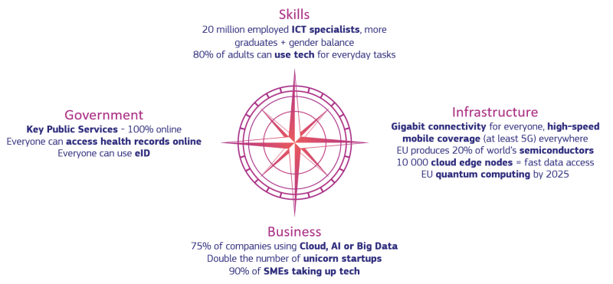
5. Aligning VET with Europe’s Digital Transition
preparing the workforce for digital and green jobs,
supporting SMEs in adopting digital solutions
VET institutions play a key role by:
contributing to innovation ecosystems,
promoting social inclusion through accessible digital learning
https://www.consilium.europa.eu/en/policies/digital-transition/#opportunities

Slide 20
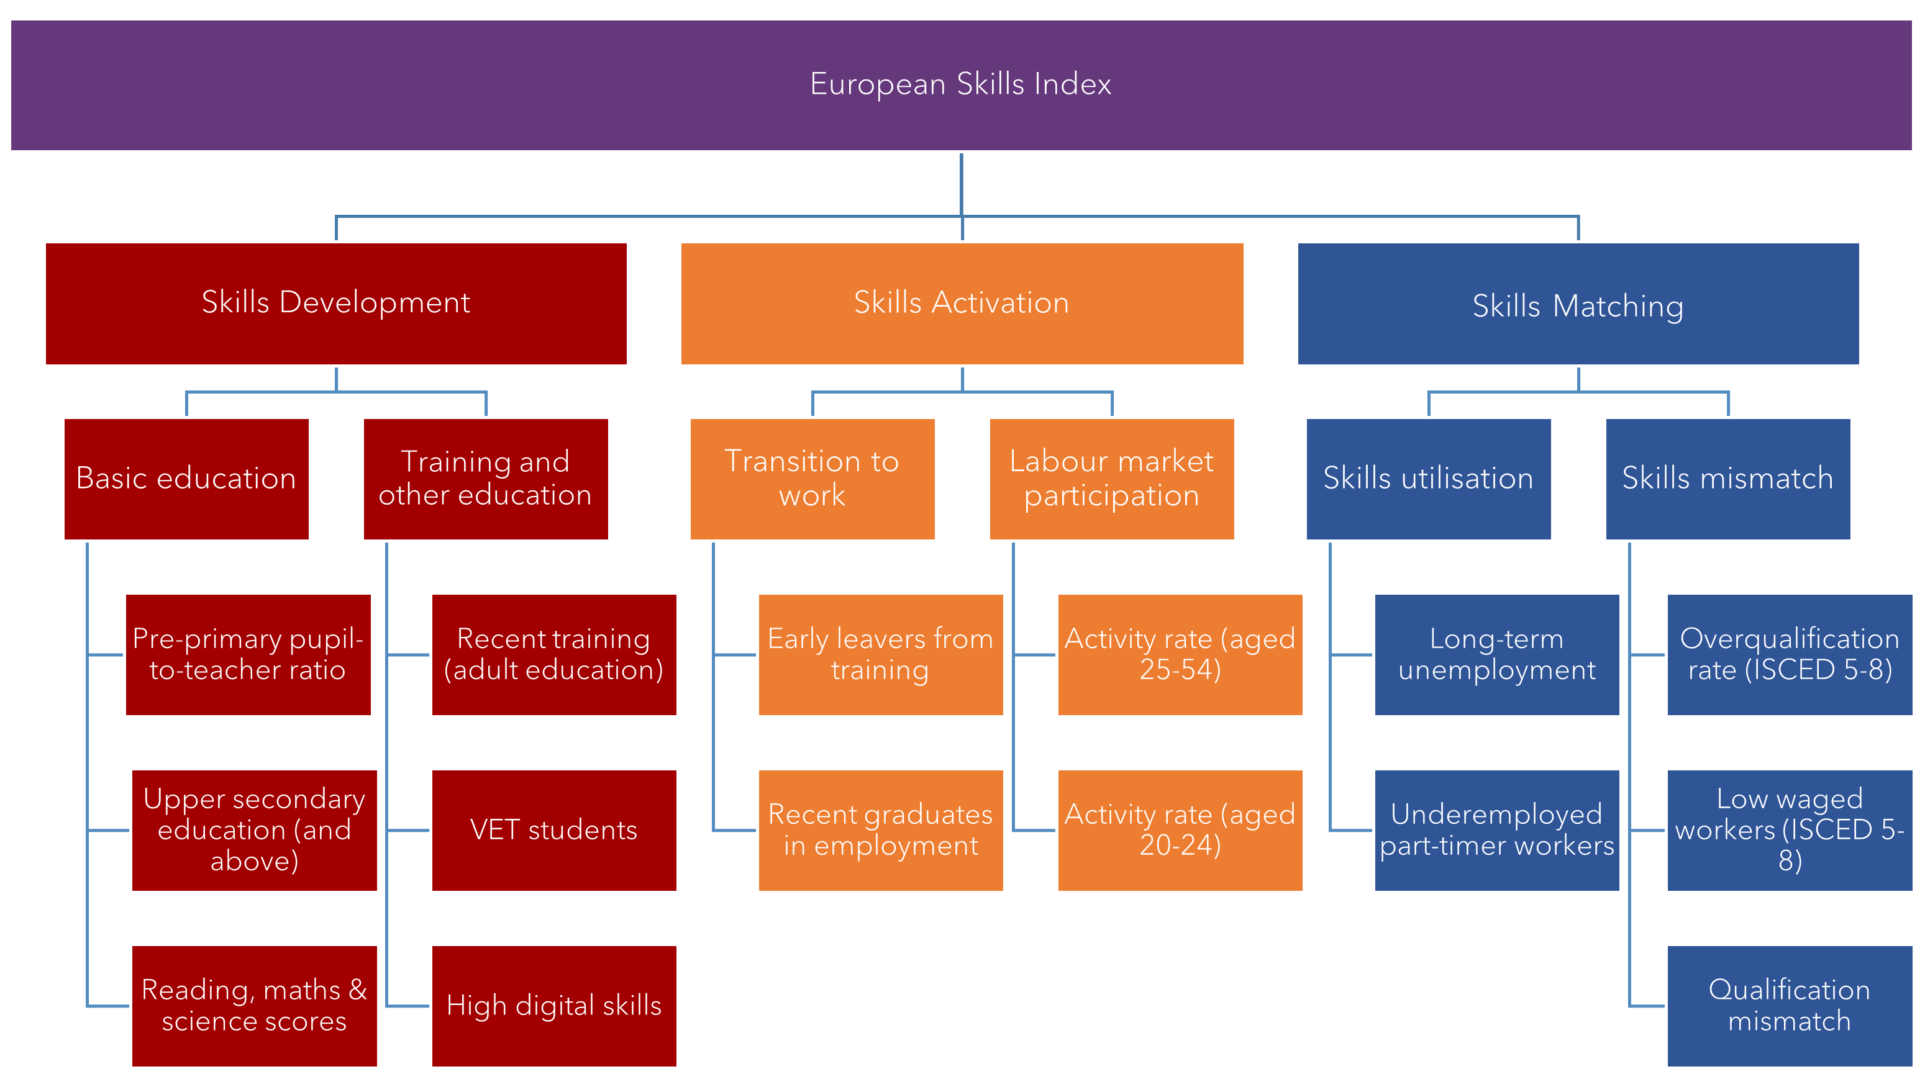
5. Aligning VET with Future Skills Agenda
https://www.cedefop.europa.eu/en/tools/european-skills-index

Slide 21
Educators
Policymakers
Companies
Learners
AI
VET

Slide 22
Thank you
for your attention

